Slide 1
DL Optimization— “Changes the Game” Rajesh Jeyapaul Architect & Client Technical Lead

Slide 2
Agenda
ML – an optimization problem 00
SVM Kernel 00
Apache spark and SVM kernel – Watson Studio Demo 00
00
00
Strategies to accelerate Deep Learning 00
Reduced precision , GPU bandwidth &
DDL
GPU enabled Resnet32 and CiFAR10 – Watson Studio Demo 00
00
Distributed Deep Learning as Service
00
00
00

Slide 3
ML – an optimization problem y=f(x) Weight = B0 +B1*Height
Weight | Height
80 | 165
75 | 178
86 | 180

Slide 4
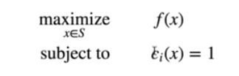
Optimization – Techniques to find best value from a set of choices….
A well-posed optimization has atleast 2 parts:
Optimization Domain
A set S of possible choices
Objective function f() = min /max
Loss/Cost function (min)
Utility function (max)
We can add “Constrain” as a third component as well

Slide 5
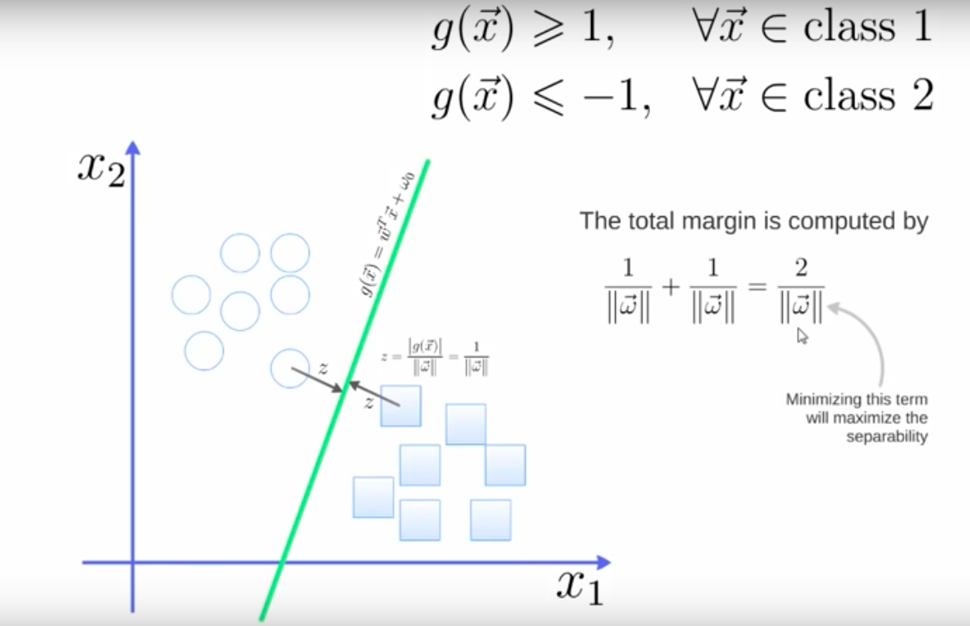
SVM Classification
Minimize the weight vector will maximize the distance->
Which is a non linear optimization task

Slide 6
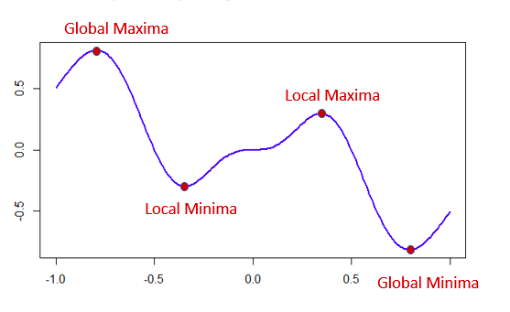
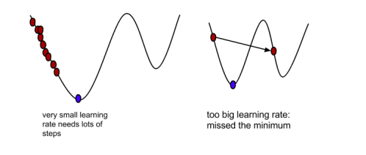
Optimization Challenge
General purpose optimization is hard and near impossible
Number of candidates in the search space grows exponentially
Search algorithms gets trapped in local minima
One of the ways to separate local and global minimums is to avoid too fast convergence for optimal value.
We can do much better if we can assume that our objective are well-behaved
Convex functions are well behaved
Notes:
Rolling the ball from cliff – reaches the minimum (bottom) – Global minimum – Optimal Valley
Local minimum – sub-optimal valley

Slide 7
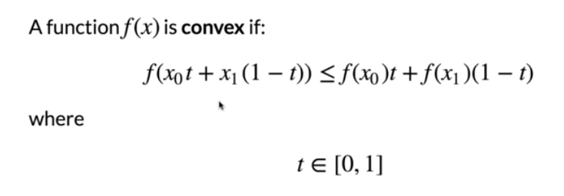
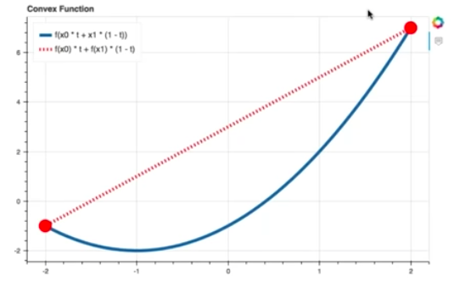
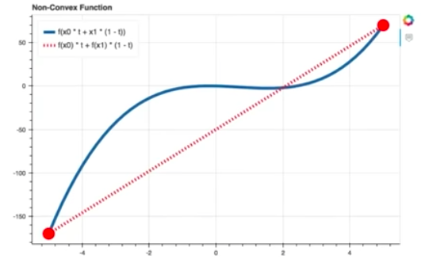
Convex Function
Text here …

Slide 8
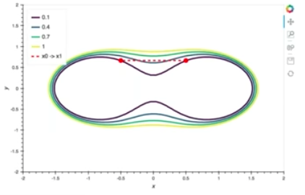
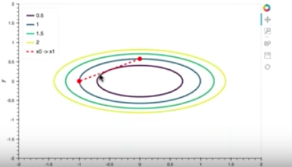
Multivariate
Convex vs non-convex

Slide 9
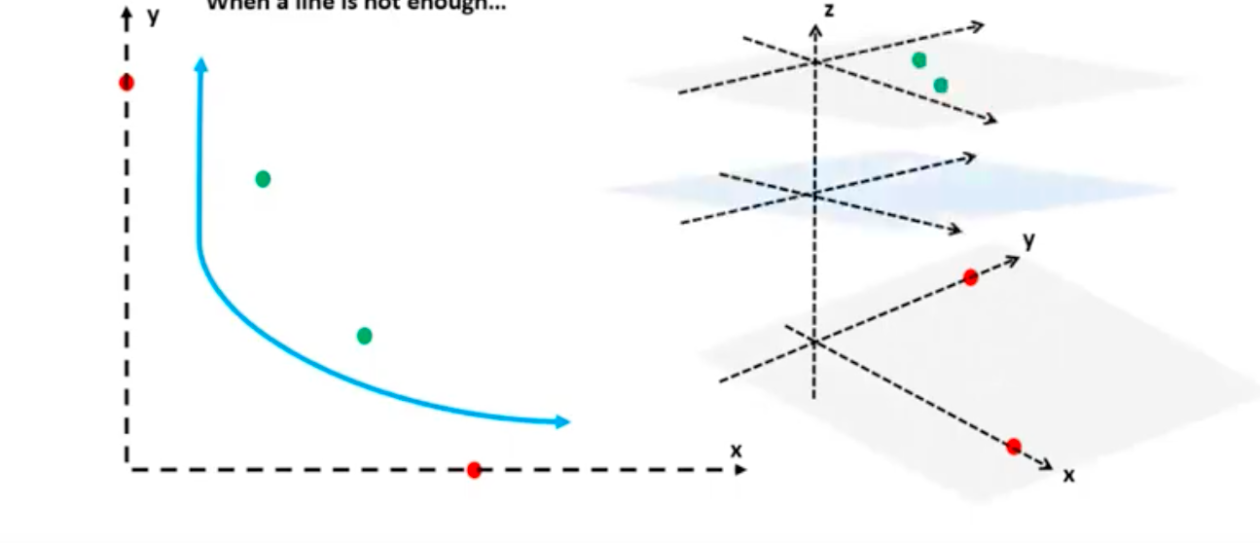
SVM kernel Optimization

Slide 10
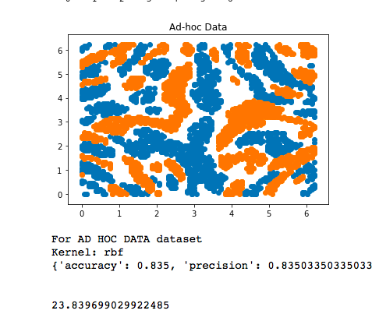
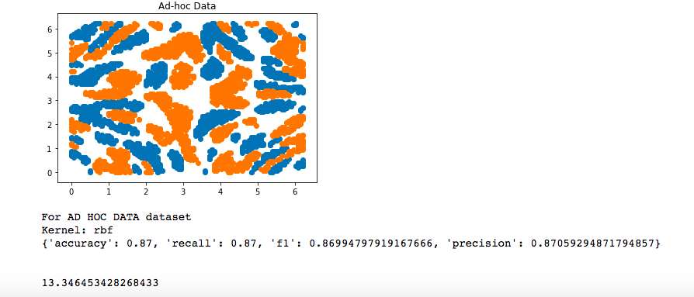
Cloud Apache Vs Local CPU
With Gamma and lower C ,accuracy reduces
* - Apache Spark did not make use of the Spark MLiB Libraries in this case
Notes:
Large C gives low bias and high variance (overfit)
https://www.quora.com/What-are-C-and-gamma-with-regards-to-a-support-vector-machine
Gamma – 0.001 and 0.00

Slide 11
How do you define the metric for digital computation ?
Number of operations performed per second per unit power. (ops / s/ W)
Higher Accuracy
Work done * time
No. of flops / sec
Number of operations performed per second per unit power. (ops / s/ W)

Slide 12
Understand Deep learning (CNN)

Slide 13
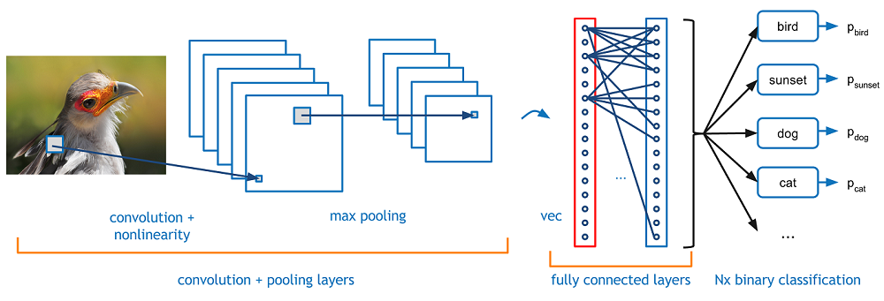
Convolutional Neural Network (CNN) – Feature extraction…

Slide 14

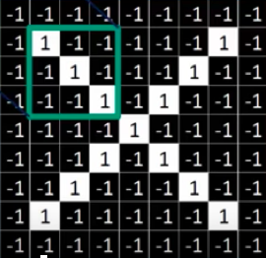
Understand CNN

Slide 15
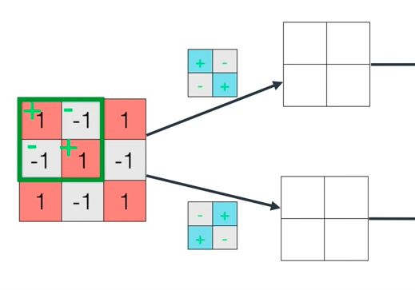
Convolution - Filters

Slide 16
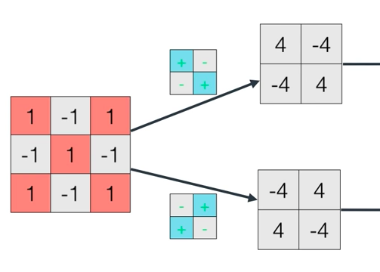
Convolution and Pooling

Slide 17
What is the primary computation that happens during convolution ?
Vector cross product
2 flops -> matrix multiplication and addition
Feature map creation
Addition and Subtraction of 2 matrix

Slide 18
Convolution - Normalization
1 | 0.5
0.5 | 1
0.5 | 1
1 | 0.5

Slide 19
Multi Layer CNN
1 | 0.5
0.5 | 1
Convolution
1 | 0.55
0.55 | 0.55
ReLU
“N”
Pooling
0.5 | 1
1 | 0.5

Slide 20

Fully Connected Layer
1
0.5
0.5
1
1
0.55
0.55
0.55
0.5
1
1
0.5
0.9
0.45
0.53
0.87
0.96
0.43
0.45
0.51
0.53
0.88
0.94
0.53
1 | 0.5
0.5 | 1
1 | 0.55
0.55 | 0.55
0.5 | 1
1 | 0.5

Slide 21
Memory constraints
Image – 224x224x3
3 conv layers
Filters (Kernel) – 64
Stride - 1
Padding – 1
Activation volume – 224x224x64 -> 10million activations
72MB of memory per image

Slide 22
Strategies to accelerate deep learning
-> Reduced precision/Choice of fixed point or floating point
https://www.ibm.com/blogs/research/2018/12/8-bit-precision-training
-> GPU scaling
-> Distributed Deep Learning

Slide 23
Across the range of datasets and neural networks, what is the reduced training and Inference precision recently achieved ?
8 bit precision for training and 4 bit for precision for inference
Ibm.com/research -> 8 bit precision for training deep learning systems – Naigang Wang , Jungwook and Kilash
32 bit training and 16 bit inference
16 bit training and 16 bit inference
16 bit training and 8 bit inference
8 bit training and 4 bit inference

Slide 24
Reduced precision – Trade Numerical precision for computational throughput enhancements
Most pervasive Arithmetic function used in deep learning is the dot product between 2 vectors
Multiply-Accumulate (MAC) needs 2 floating-point operations , C -> C + aXb
Precision of “C” – rounding of Mantizza creates accumulation error
Paper -> “Accumulation Bit-Width Scaling for ultra-low precision Training of Deep Networks”
* - If large data needs to be processed, then processor core is easily starved for data
Notes:
Each register can hold more numbers – speed up computation

Slide 25
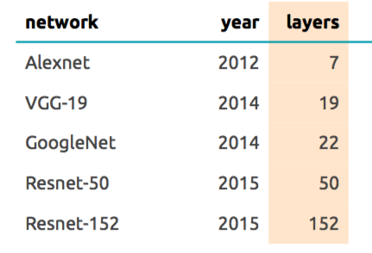
Memory and Computation Consideration
Improving accuracy:
Add More layers – more memory
Memory to store outputs of intermediate layers (forward pass)
Memory to store parameters
Memory to store error signal at each neuron
Memory to store gradient of parameters
Any extra memory needed by optimizer (eg. for momentum)

Slide 26
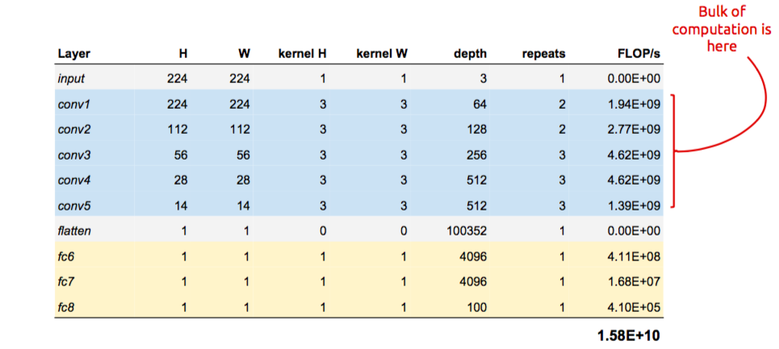
Mini batch SGD yields stable gradient estimates and faster training

Slide 27
GPU based training scaling
GPU is good but..
Latency in moving the data to GPU
Current throughput achieved is 300GB/s – NVLink 2.0

Slide 28
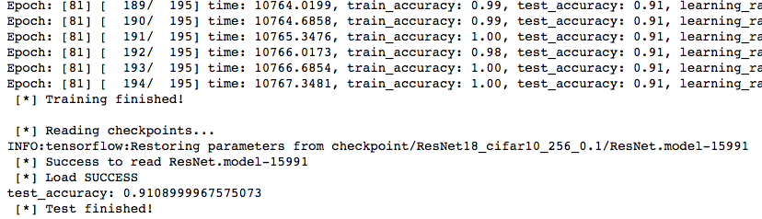
Data
While GPUs have helped accelerate training, the amount of data as well as complexity of models have increased the computation need beyond the capability of a single GPU. For example, training on 2.5 million images on a single GPU can take 6 days on a simple model
Epochs – 82
Training duration – 3hrs 30mins
Accuracy -
Parameters -

Slide 29
Core component of Deep Learning - Bkup
Heart of Backward propagation -
Matrix Multiplication
Weight update
Application of activation function

Slide 30
Distributed Deep Learning
Text here …

Slide 31
Distributed Deep Learning
Design Principle
Multiple GPU for learning task
Exploits elastic scalability of cloud
Data persistence
Flexibility to use any of frameworks – Tensorflow , Caffe, Torch

Slide 32
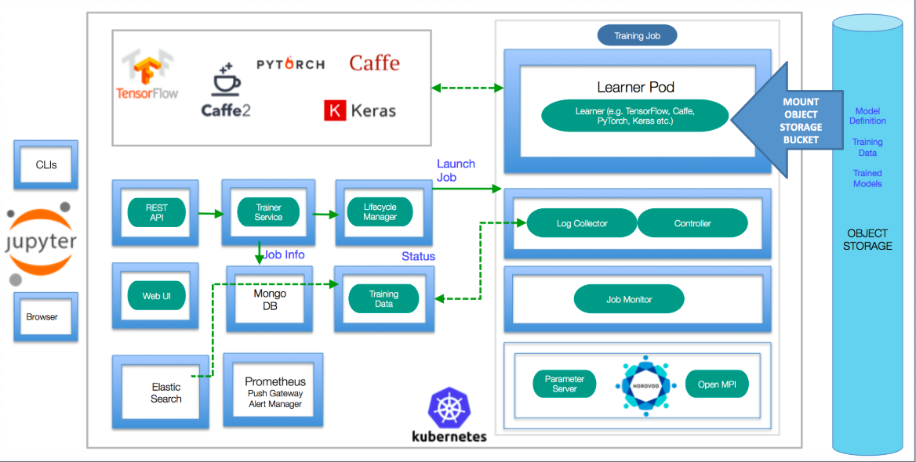
Distributed Deep Learning - Architecture

Slide 33
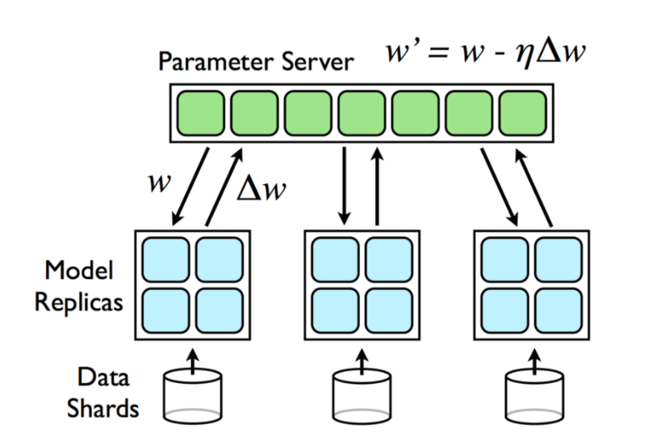
Distributed Deep Learning
Text here …

Slide 34
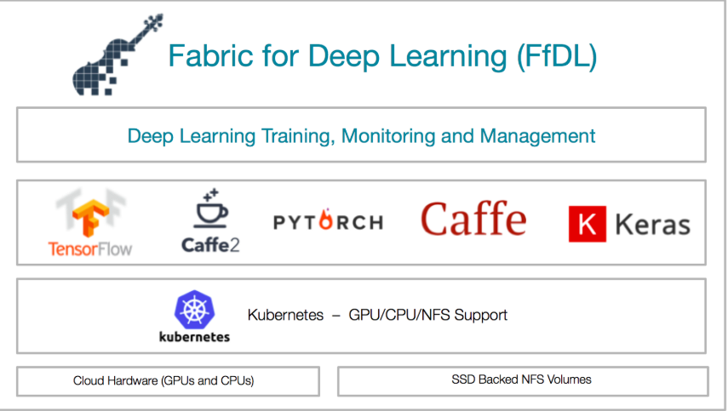
Distributed Deep Learning - Architecture
Text here …

Slide 35
Distributed Deep Learning – Orchestration of Jobs
Interaction of Learners and Parameter servers
Learner –
Multiple Learner for Data parallelism, Each Learner implemented in DL framework (TF)
Each Learner works on Mutually exclusive chunk of data
Each Learner is allotted GPU/CPU
Learner Co-ordination:
Each Learner has entire copy of Model
Model weights are updated as a result of training on new chunk of data
Parameter server is used to aggregate the weights
Learner does the push and pull of weights to/from Parameter server

Slide 36
Distributed Deep Learning as Service (DLaaS)
Data – CIFAR10
Network – 3 convolutions, 2 FC
Accuracy – 71%
Training Duration with GPU – 4 hrs
Can you improve the accuracy to > 71% in one hour ?
85 DL experts and most of them no prior experience on the framework, able to improve the efficiency in less than hr.(72.3 to 77% accuracy)
Usage Experience:
Prepare the DL Model
Upload Model and training data
Start the training job
Download the trained Model

Slide 37
Topic
Text here …

Slide 38
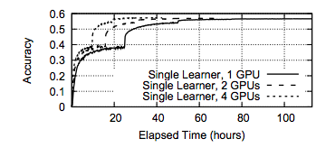
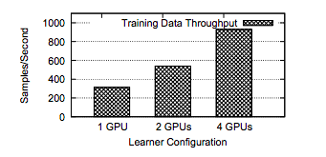
Topic
Caffe AlexNet Model
Imagenet – 1K datasetEpochs- 90
Batch size – 256 images
Total image – 1.3 million
1GPU training duration – 100hrs
4GPU training duration – 40hrs

Slide 39
Topic
2 learners , 4GPU vs 8GPU
Batch size – 2048 images/run
8GPU – 1752 images/sec
4GPU – 1040 images/sec
Challenge:
To reap the benefit of distributed, use large batch size,so that compute:communication ratio is high.
Large batch size leads to slow convergence unless other paramters liks C are appropriately tuned
Inter GPU communication to be improved

Slide 40
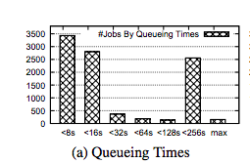
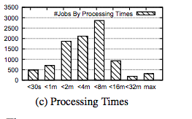
Topic
Caffe AlexNet Model
Imagenet – 1K datasetEpochs- 90
Batch size – 256 images
Total image – 1.3 million

Slide 42
Bkup

Slide 43
Choice of Fixed point or floating point (combine it with previos - Backup
Need to understand the impact of this on the performance and versatility of a given network architecture
Is there a way to replace 2 nxm floating point operation (mul & add) associated with matrix-vector mul by one single operation?
Notes:
64-32 bit floating point arithmetic critical for scientific computing tasks simulating human heart , space shuttle trajectories

Slide 44
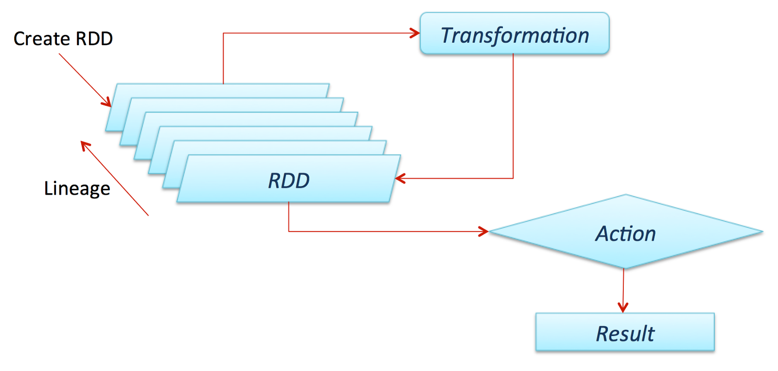
Apache Spark architecture - Bkup
Text here …

Slide 45
Apache Spark Run - Bkup
Training_size = 2000
Test_size =100
C – 1-10 (Grid search)
Gamma – 0.001 and 0.0001
N=2
Accuracy – 0.53
Accuracy – 0.87 (No Gamma)
Time – 13secs
With C=10, accuracy -0.96 and
Time 12secs
Notes:
Large C gives low bias and high variance (overfit)
https://www.quora.com/What-are-C-and-gamma-with-regards-to-a-support-vector-machine

